Slide 1
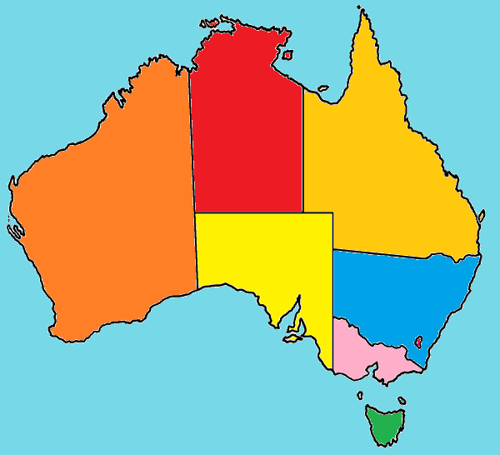
Our Country
“Australia”

Slide 2
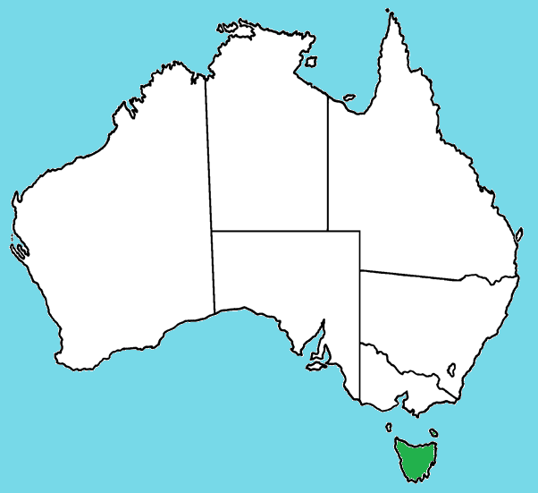
Name the State - Territory

Slide 3
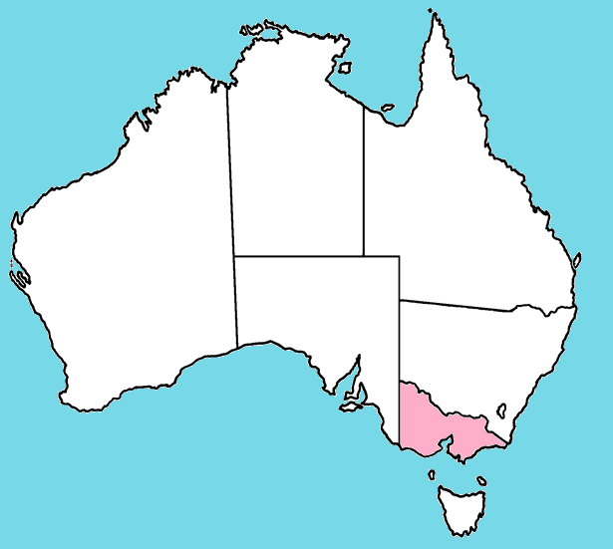
Name the State - Territory

Slide 4
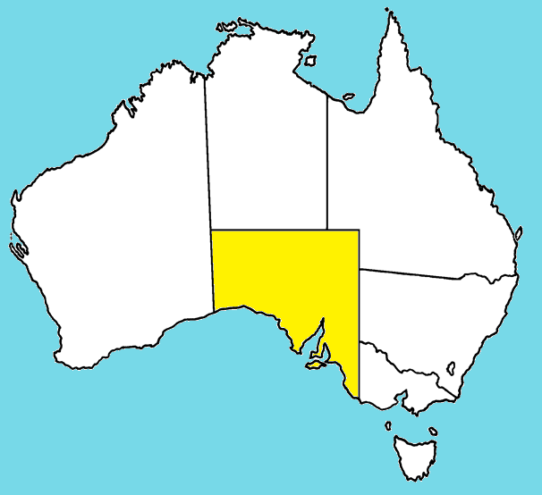
Name the State - Territory

Slide 5
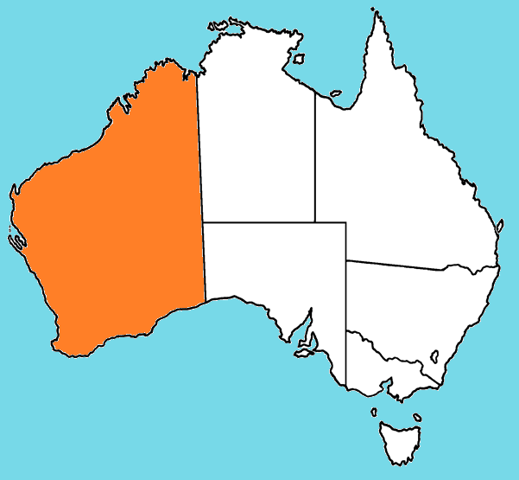
Name the State - Territory

Slide 6
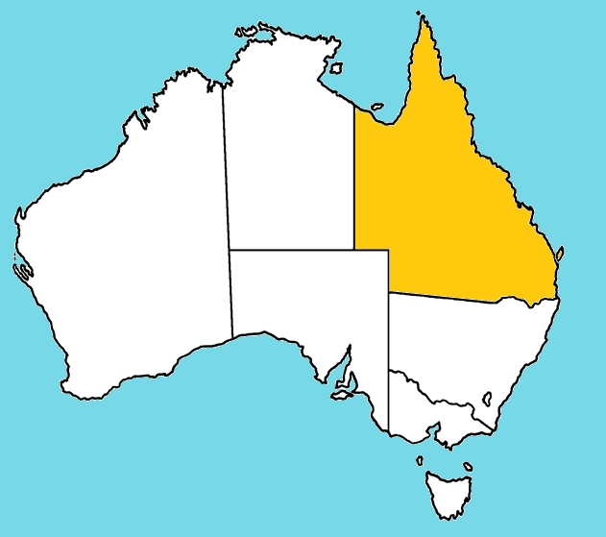
Name the State - Territory

Slide 7
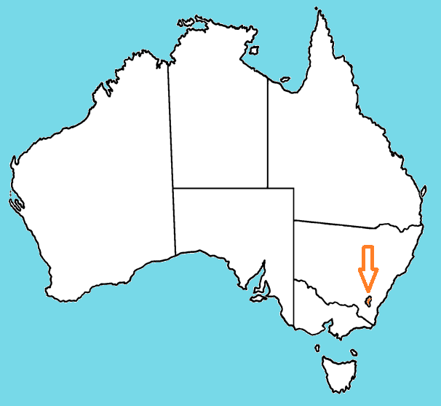
Name the State - Territory

Slide 8
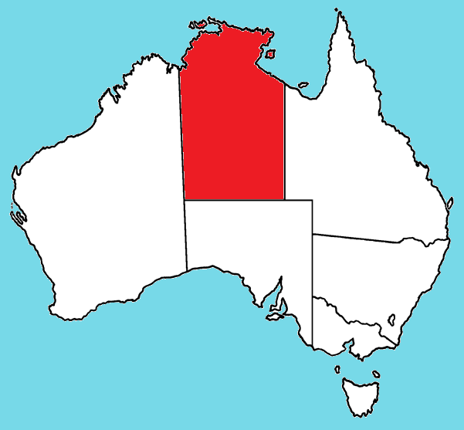
Name the State - Territory

Slide 9
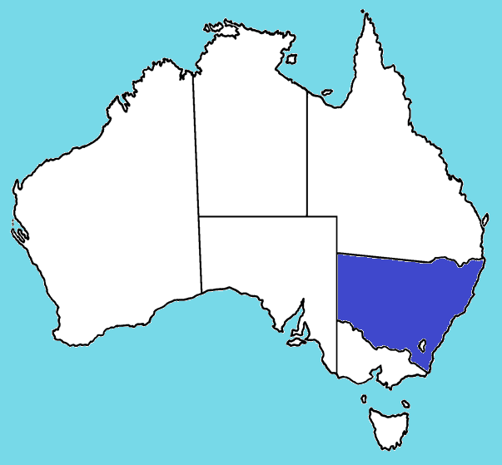
Name the State - Territory

Slide 10
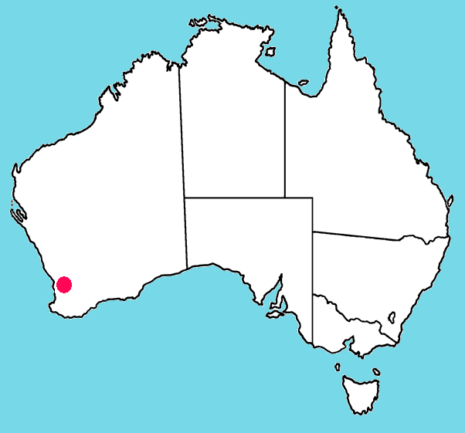
Name the capital city

Slide 11

Name the capital city

Slide 12
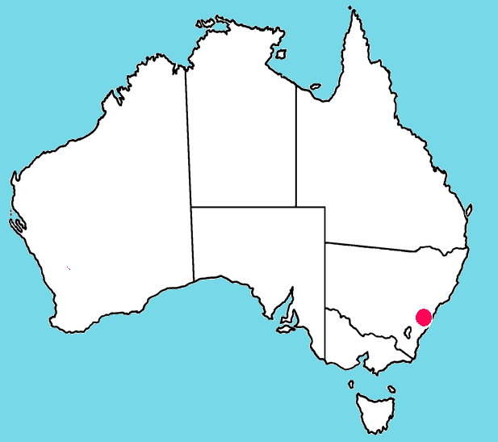
Name the capital city

Slide 13

Name the capital city

Slide 14

Name the capital city

Slide 15
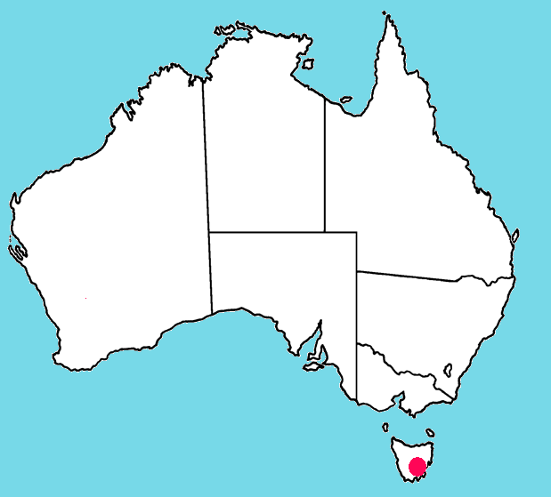
Name the capital city

Slide 16
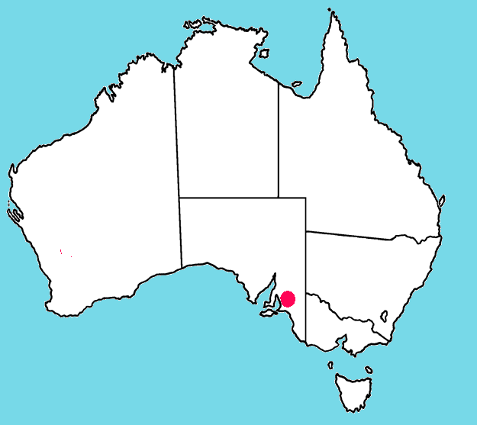
Name the capital city

Slide 17

Name the capital city

Slide 18
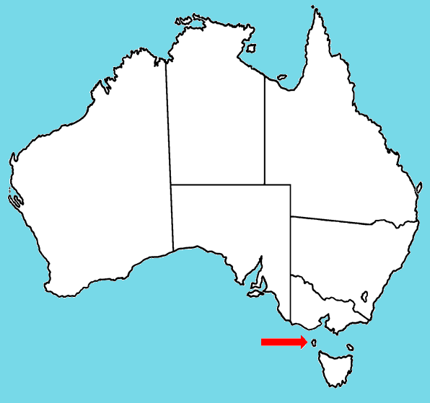
Name the island

Slide 19
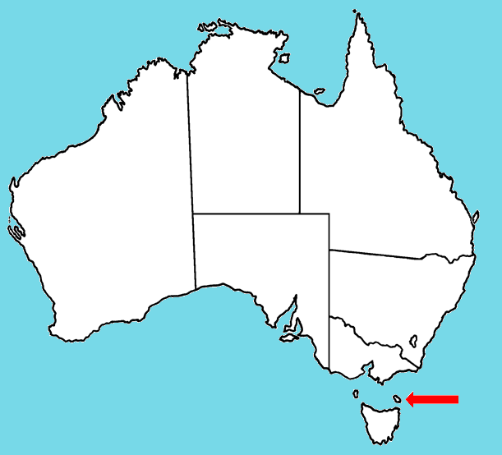
Name the island

Slide 20
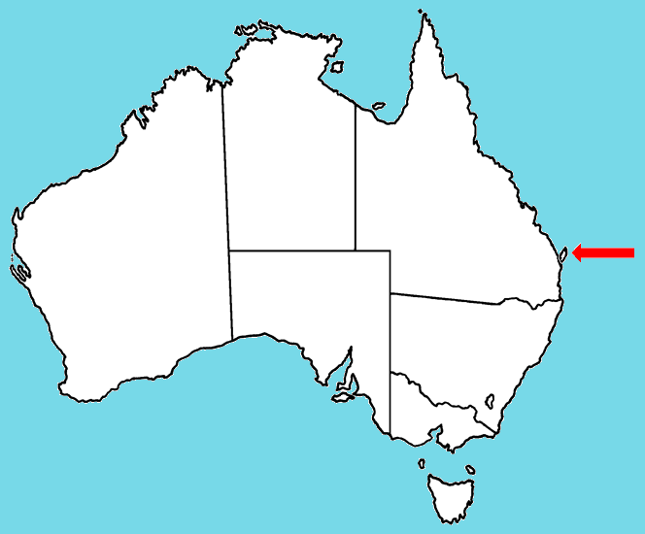
Name the island

Slide 21

Name the island

Slide 22


Name the place

Slide 23
Name the place

Slide 24
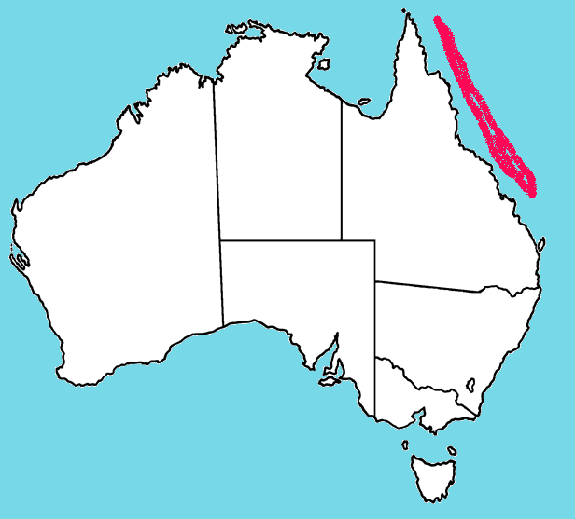
Name the feature

Slide 25
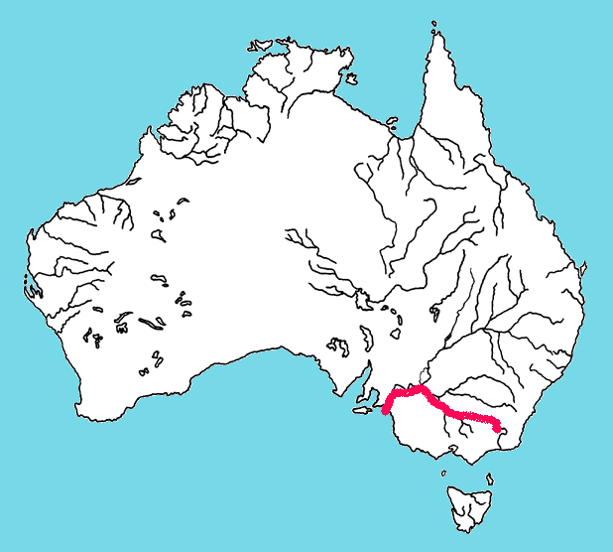
Name the river

Slide 26
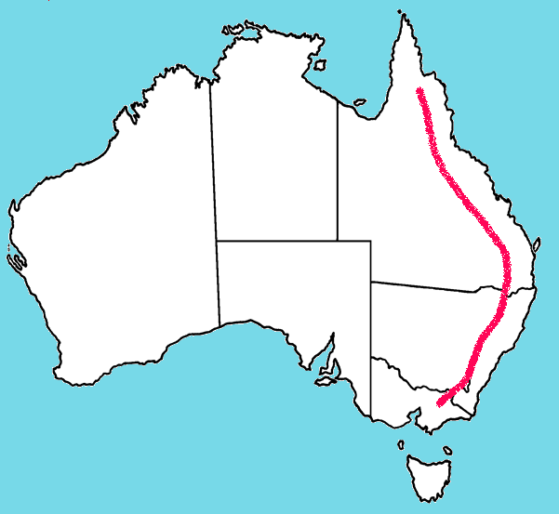
Name the feature

Slide 27
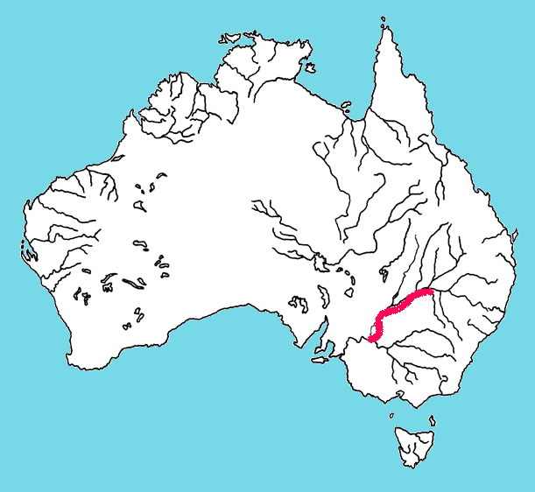
Name the river

Slide 28
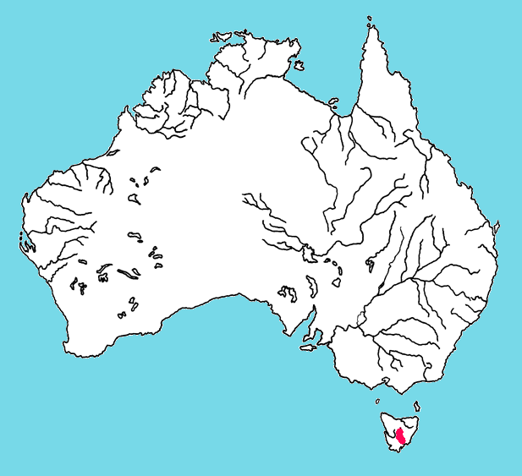
Name the river

Slide 29
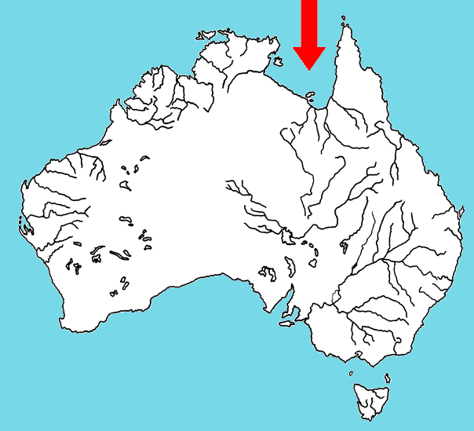
Name the body of water

Slide 30
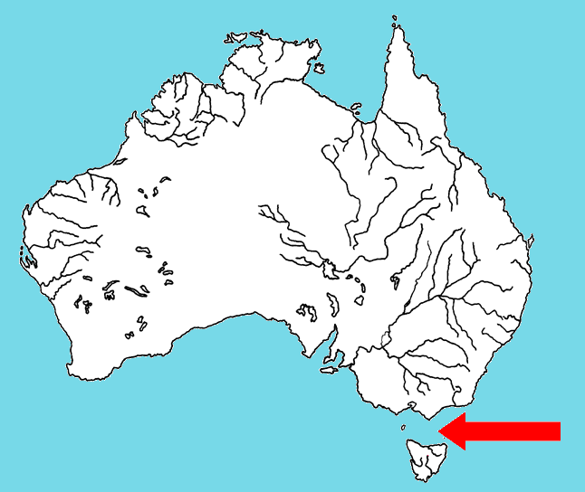
Name the body of water

Slide 31
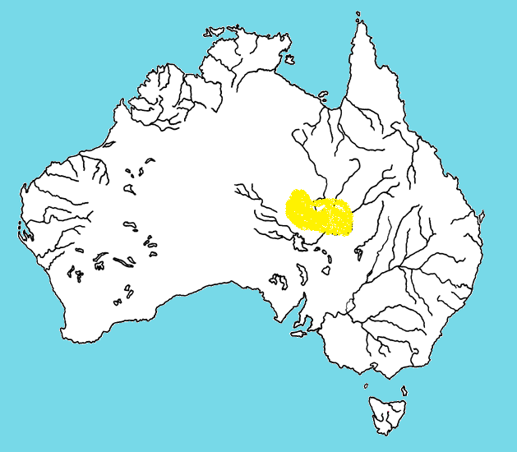
Name the desert

